Slide 1

ONOS Installation and Build
Teaching brigade, ONF
Andrea Campanella, ONF, USA
Abdulhalim Dandoush, ESME-SUDRIA, France
Lefteris Manassakis, ICS FORTH,Greece
ONOS Build, SAMSUNG Seoul
September 20, 2017

Slide 2
Slides and VM download Links
Slides : https://goo.gl/1BjLWa
VM : https://goo.gl/i1d9Rs

Slide 3
Outline
Import Ubuntu VM in VirtualBox
Download and install ONOS
Install prerequisites, set environment variables, run ONOS
Install Mininet
Create a topology for ONOS
ONOS Ecosystem
Basic commands and interfaces (CLI, GUI, REST)

Slide 4
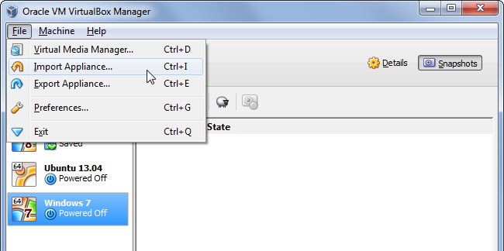
Importing the Ubuntu VM
Click Import Appliance

Slide 5
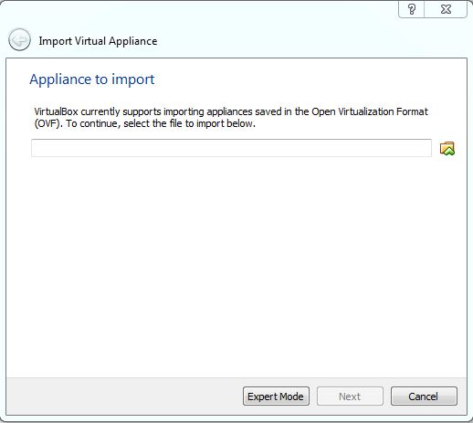
Importing the Ubuntu VM
Click the folder icon on the right

Slide 6
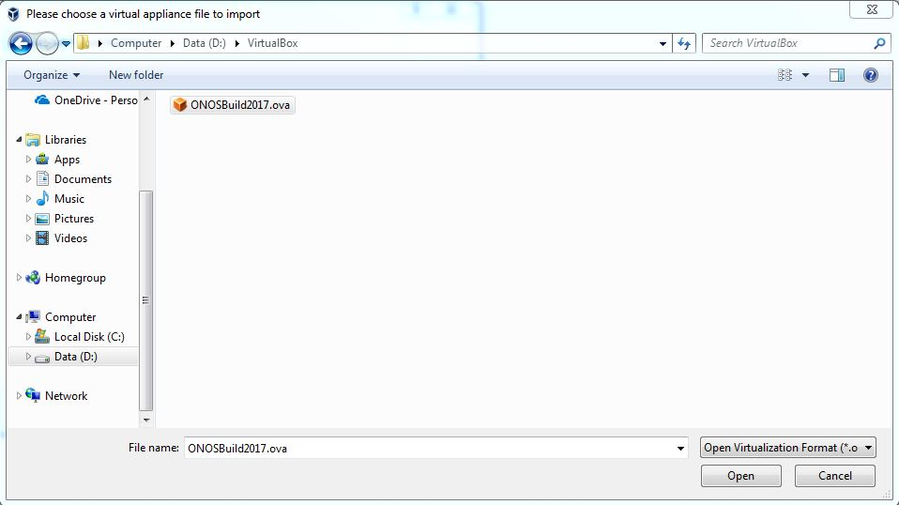
Importing the Ubuntu VM
Browse to the .ova file and click open

Slide 7
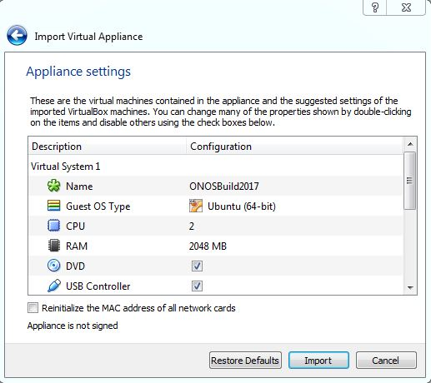
Importing the Ubuntu VM
Click Import

Slide 8
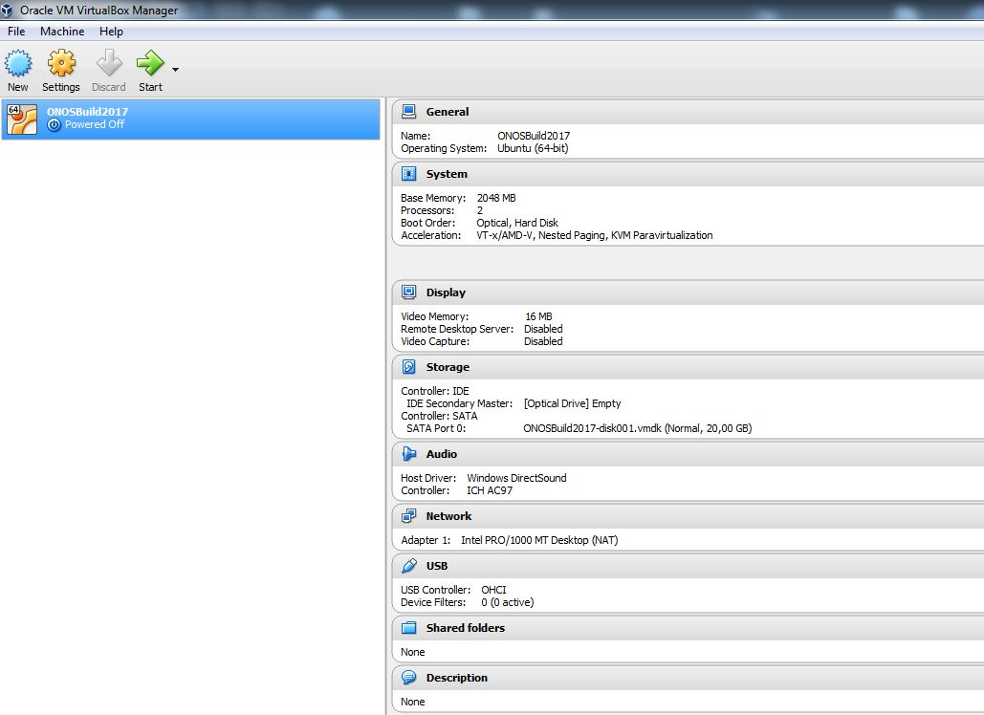
Booting the Ubuntu VM
Click Start
Notes:
Starting from the home folder ( cd ~), copy/paste this command

Slide 9
Mininet Setup
Download and Install Mininet:
$ git clone https://github.com/mininet/mininet
$ cd mininet
~/mininet$ git tag (optional)
~/mininet$ git checkout 2.2.2
~/mininet$ ./util/install.sh -fnv
-fnv: Openflow, Dependencies/Core Files, OVS Switch

Slide 10
ONOS Setup
Download ONOS:
~/mininet$ cd ~
$ git clone https://github.com/opennetworkinglab/onos.git
Setup ONOS Environment Variables:
$ echo '. ~/onos/tools/dev/bash_profile' >> ~/.bashrc
$ source ~/.bashrc

Slide 11
Run ONOS
Running ONOS single instance using buck:
$ cd onos
~/onos$ rm –rf buck-out/ -> cache 삭제
~/onos$ buck run onos-local -- clean debug
Wait until the running log stops

Slide 12
Run Mininet
Running Mininet using a tree topology:
Open a new terminal:
$ cd mininet
~/mininet$ sudo mn --controller=remote,ip=127.0.0.1,port=6633 --mac --topo=tree,2,2 --switch=ovsk,protocols=OpenFlow13

Slide 13
Basic Mininet Commands
Ping all hosts:
mininet> pingall
From H1 ping H4:
mininet> h1 ping h4
Ctrl + c to stop the ping

Slide 14
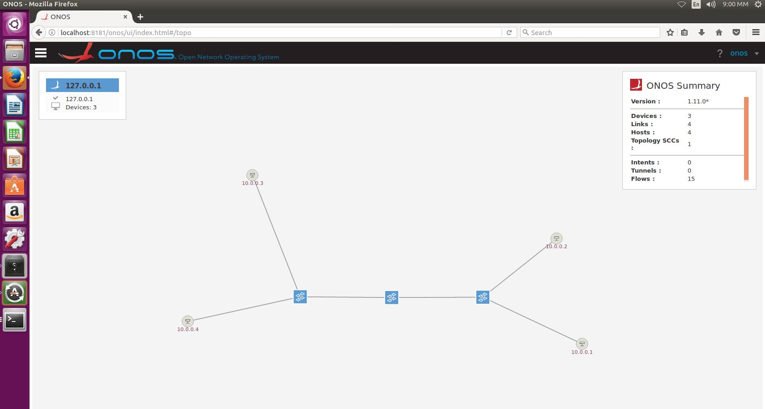
ONOS GUI
http://localhost:8181/onos/ui user: onos password: rocks

Slide 15
ONOS CLI
Enter ONOS CLI:
$ cd onos
~/onos$ onos localhost

Slide 16
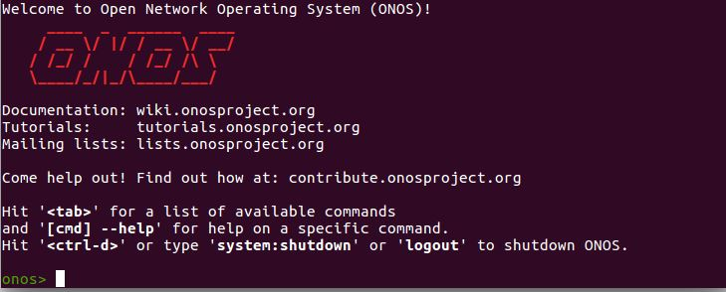
ONOS CLI
ONOS CLI Interface:

Slide 17
ONOS CLI
Basic CLI Commands:
onos> help
onos> “command” --help
onos> apps -a -s
onos> app deactivate, app activate org.onosproject.*
onos> devices, links, hosts
onos> flows
onos> paths <TAB>
onos> intents

Slide 18
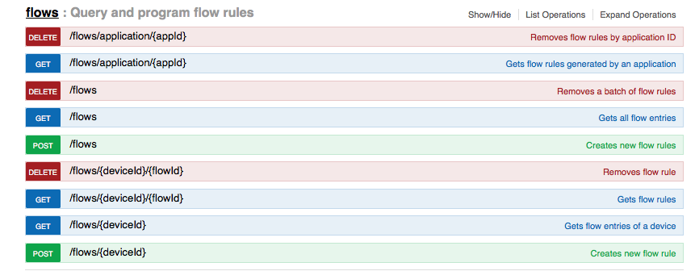
ONOS REST API
Using a web browser:
http://localhost:8181/onos/v1/docs

Slide 19
Multiple ONOS instances
$ sudo apt-get install mininet bridge-utils
$ cd ~/onos/tools/dev/mininet
$ sudo mn --custom onos.py --controller onos,3 --topo torus,4,4
Default url: http://192.168.123.1:8181/onos/ui

Slide 20

Q&A
Andrea: andrea@opennetworking.org
Lefteris: manassakis@gmail.com
Abdulhalim:adandoush@gmail.com

Slide 21

Documentation
Installing and running ONOS
Basic ONOS Tutorial
The ONOS Web GUI
Appendix B: REST API

